Slide 1

Ducks: Duck Quest
Mikayla Winant: TL3

Slide 2
Teammate Roles and Deliverables
Michael
Created Town, implemented flags in doorways/different areas of the game.
Mikayla
Added Enemy animations, TakeDamage, and Die functionality, Goblin Enemy Type
Tyler
Implemented interaction functions
Ryan
Pause/Inventory Design, Working on Sound Integration

Slide 3
Ducks: Duck Quest
Progress Overview

Slide 4
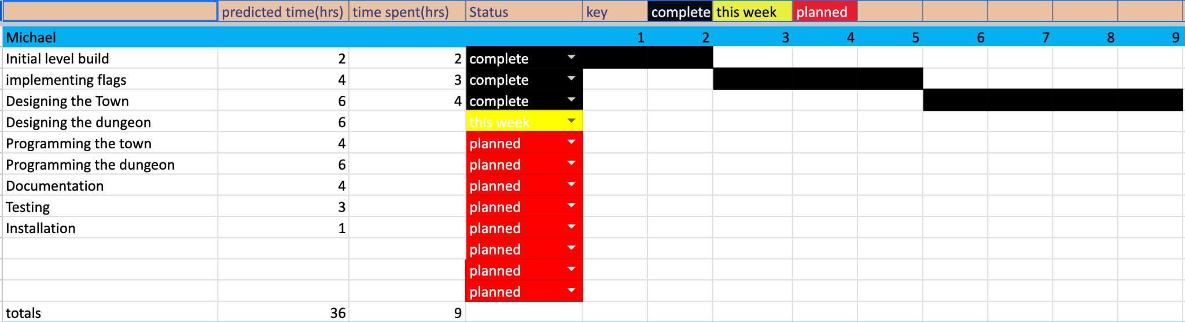
Michael’s Gantt

Slide 5
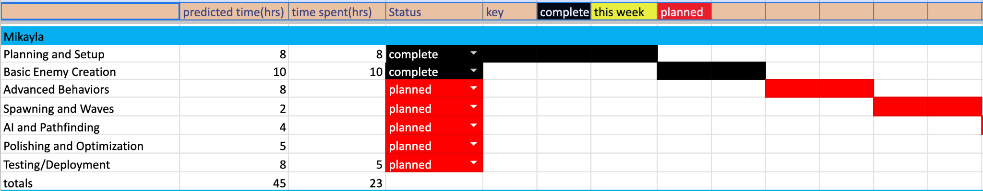
Mikayla's Gantt

Slide 6
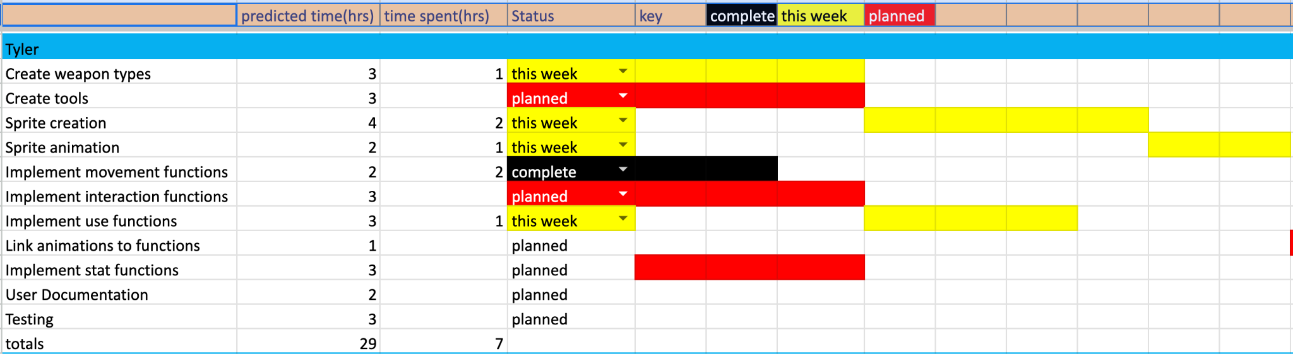
Tyler’s Gantt

Slide 7
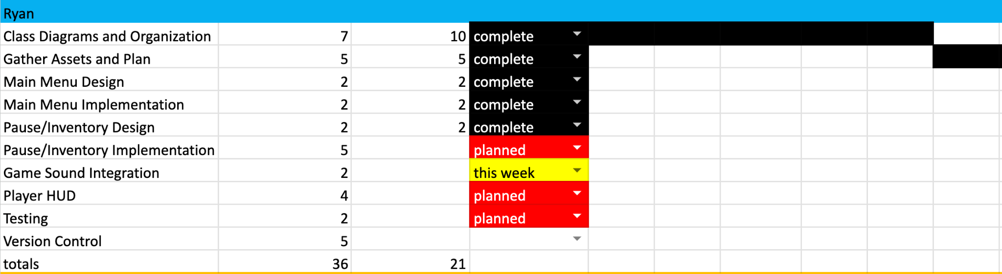
Ryan’s Gantt

Slide 8
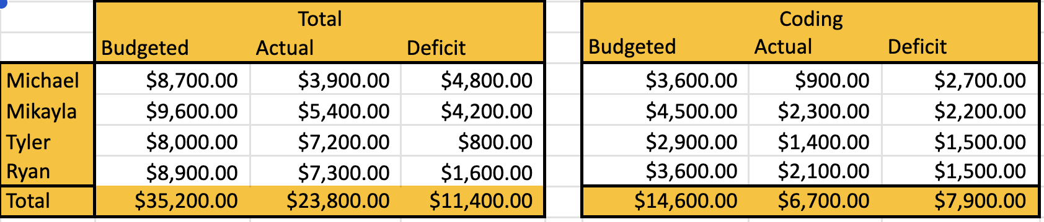

Slide 9
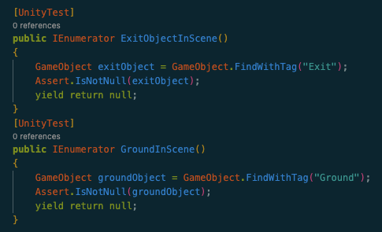
Michael’s Boundary Tests
Test that exit object exists in the scene
Test that ground object exists in the scene

Slide 10
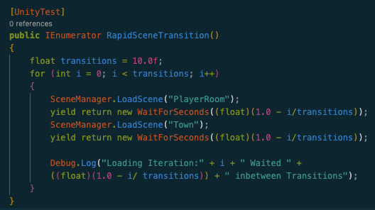
Michael’s Stress Test
Test how fast you can transition between scenes.

Slide 11
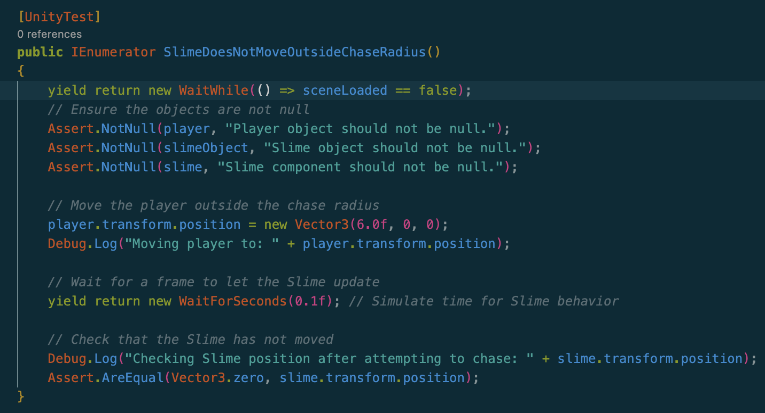
Mikayla’s Boundary Tests
Test that enemy does not move when player is outside chase radius.

Slide 12
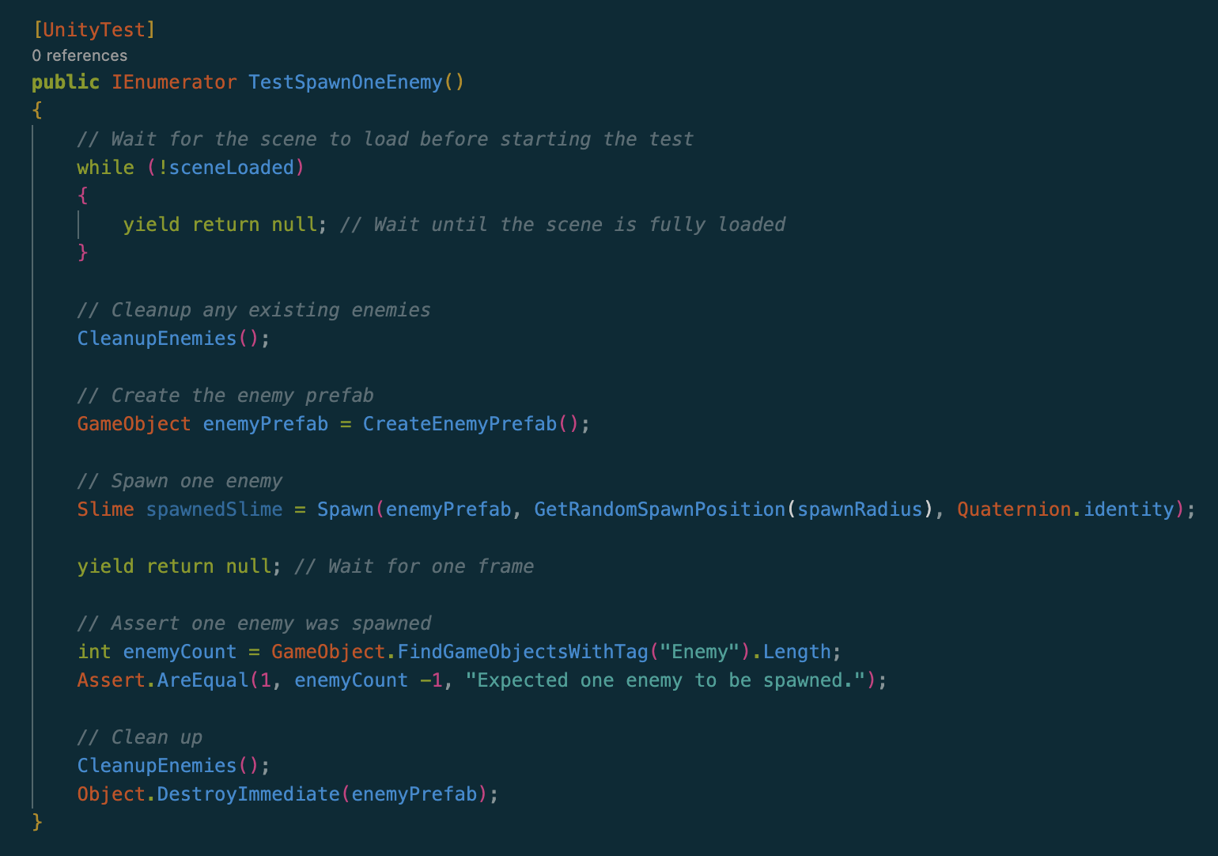
Mikayla’s Boundary Tests
2) Test that only one enemy is spawned when calling Spawn function.

Slide 13
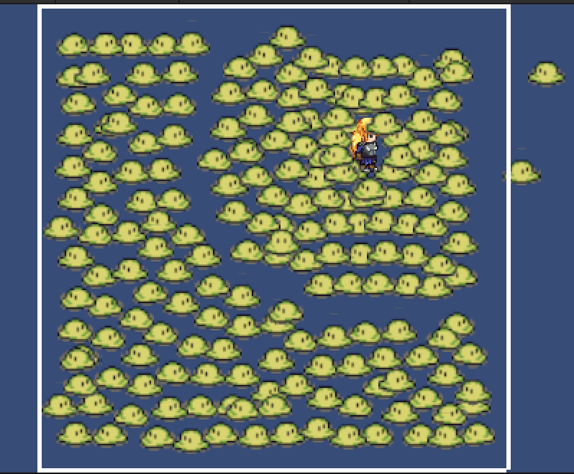
Mikayla’s Stress Test
Check max number of enemies that can be loaded into scene before wall physics are broken.

Slide 14
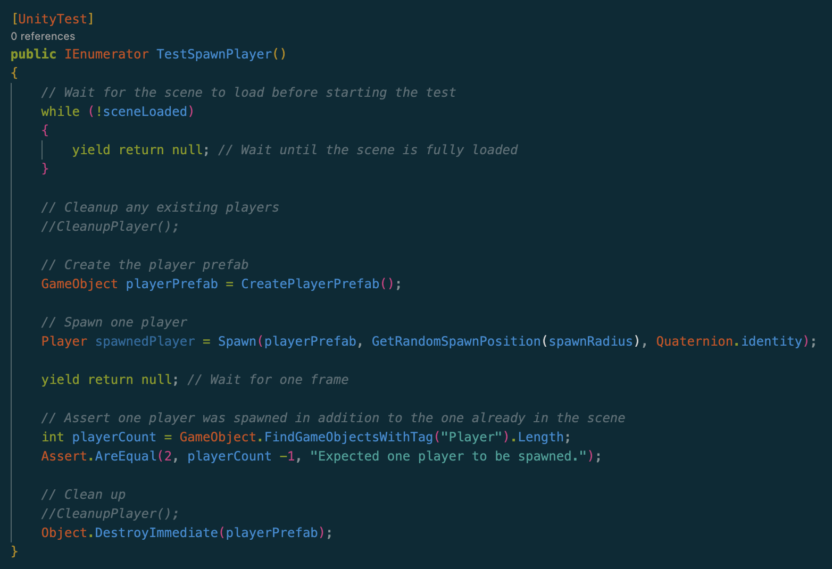
Tyler’s Boundary Tests
Test that player spawns in the scene.
Test Chest spawns in the scene.

Slide 15
Tyler’s Stress Test
Check how many chests can be loaded into the scene.

Slide 16
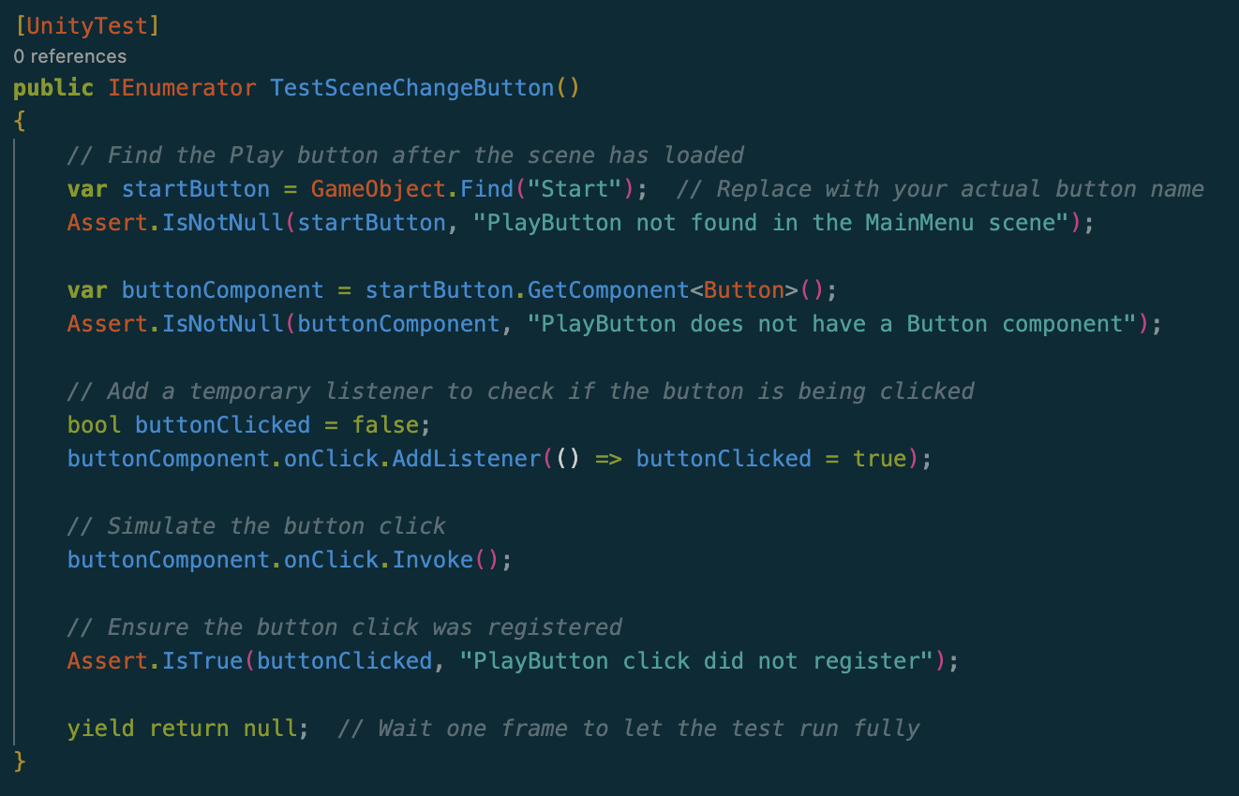
Ryan’s Boundary Tests
Test that Start Button works as intended.

Slide 17
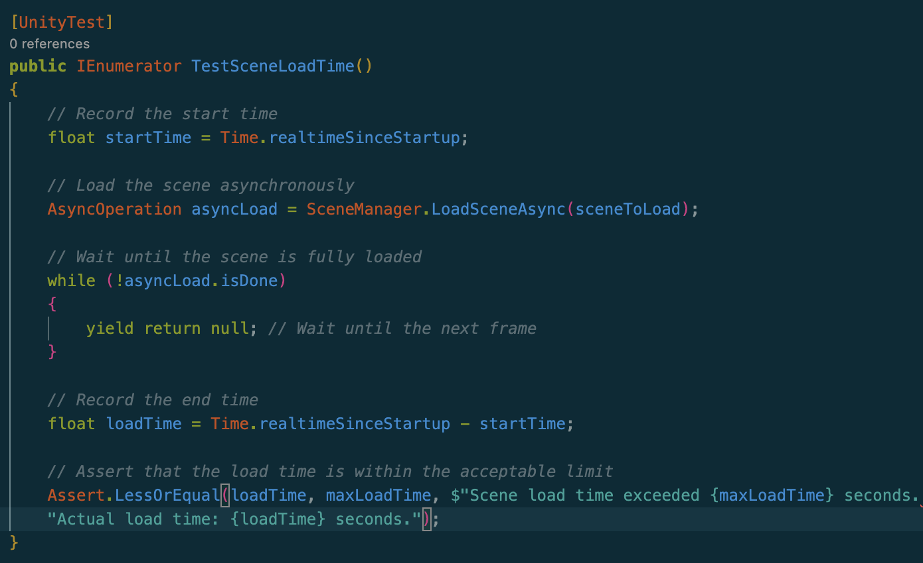
Ryan’s Boundary Tests
Test Scene Loading time is within acceptable parameters.

Slide 18
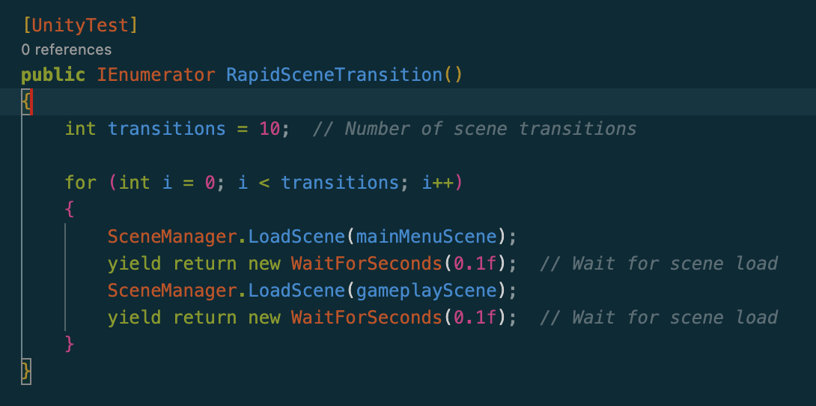
Ryan’s Stress Test
Test Rapid Scene Transition between Main Menu and Player Room Scene.

Slide 19
Game Demo

Slide 20
Ducks: Duck Quest
Questions?

